Slide 1
CENG 241 Scientific Computing

Slide 2
GRAPHICS
Basic Plotting
Linetypes, markers, colours, etc
Subplots – creating multiple axes on a single figure
Annotating figures – titles, labels, legends
Editing figure properties
Other plotting functions

Slide 3
Basic Plotting Commands
figure : creates a new figure window
plot(x) : plots line graph of x vs index number of array
plot(x,y) : plots line graph of x vs y
plot(x,y,'r--')
: plots x vs y with linetype specified in string : 'r' = red, 'g'=green, etc for a limited set of basic colours.

Slide 4
Plot(x,y,…properties)
Plot(x,y,cml) – plot with a basic colour-marker-line combination (cml)
‘ro-’, ‘g.-’, ‘cv--‘
Basic colours : r, g, b, k, y, c, m
Basic markers : ‘o’, ‘v’, ‘^’, ’<‘, ’>’, ‘.’, ‘p’, ‘+’, ‘*’, ‘x’, ‘s’, ‘h’, ‘none’
Linetypes : ‘-’, ’--‘, ‘-.’, ‘:’, ‘none’

Slide 5
More detailed plot options can be specified through the use of property:value pairs
Plot(x,y,’o-’,’property’,value)
‘property’ is always a string naming the propery, value may be a number, array, or string, depending on the property type:
‘color’ : [R G B] - color (american spelling!) is specified with a [red green blue] value array, each in range 0-1.
[1 0 0] – pure red
[1 0. 0.5 0] – orange

Slide 6
‘linewidth’ : specified as a single number. Default = 0.5
‘linestyle’ : any of line type strings - ‘-’,’:’,etc
‘marker’ : any of marker strings – ‘v’, ’o’, etc
‘markersize’ : number, default = 6
‘markeredgecolor’ : color string ‘r’, ‘g’, or [R G B] value for the line defining edge of marker
‘markerfacecolor’ : color string or [R G B] for inside of marker (can be different from edge)
Can add any number of property:value pairs to a plot command:
>> Plot(x,y,’prop1’,value1,’prop2’,value2,..)

Slide 7
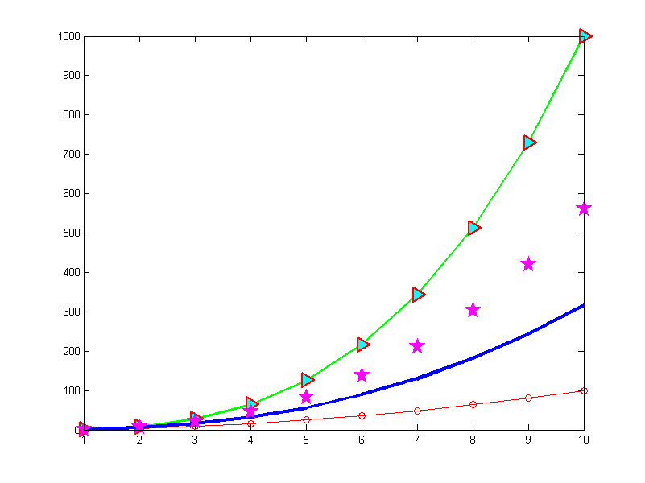

Slide 8
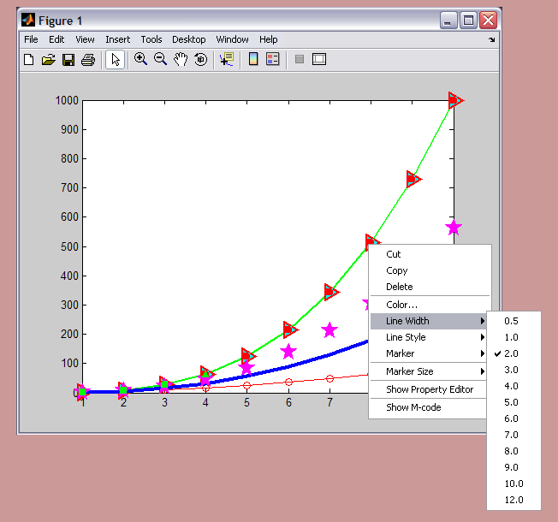

Slide 9
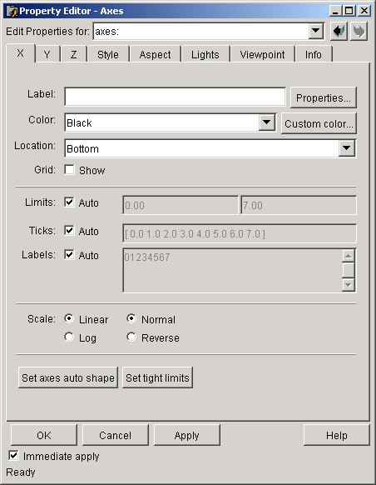
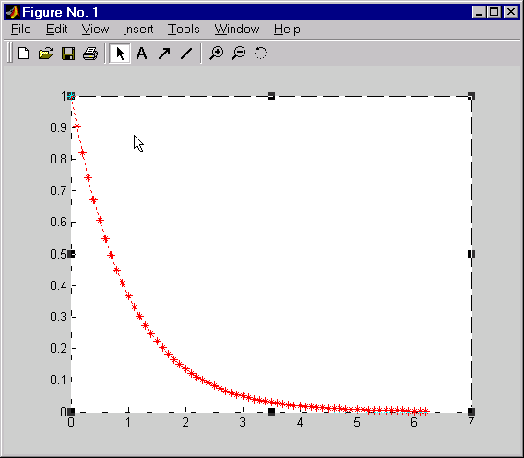
Property Editor — Axis
Edited objects
Tree of objects
Help
for object
Notes:
Property Editor – Axis
You can edit any graphical
object on a figure window
by using the Property Editor.
The Property Editor allows
you to edit properties that are
specific to the graphical object
that you selected. The example
on this page highlights the
properties of the axes in this
figure window.

Slide 10
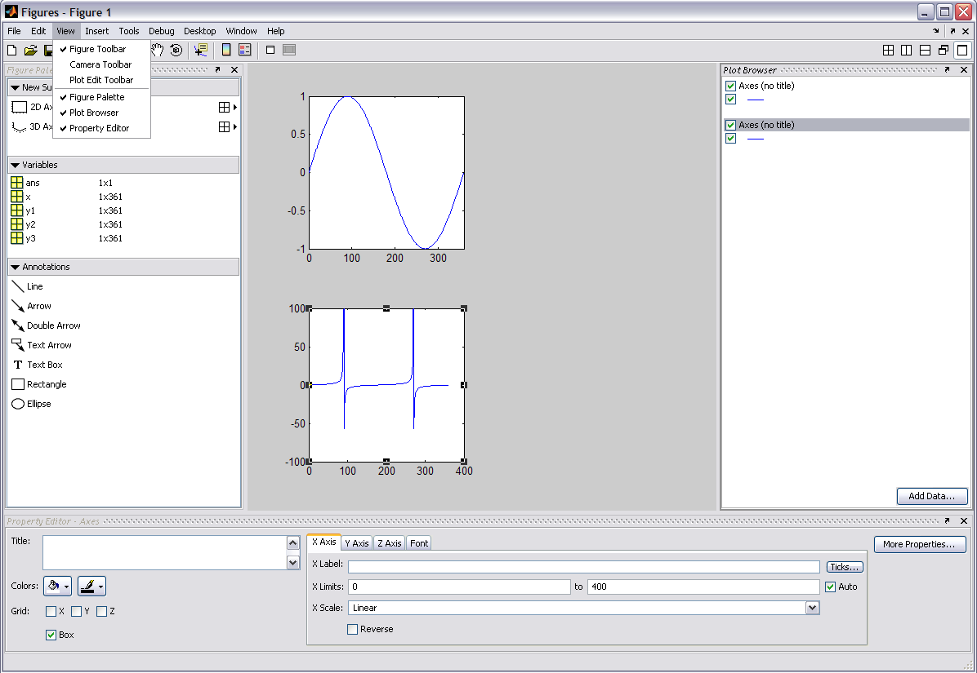
GUI property browser & editor
Access from the figure’s view menu

Slide 11
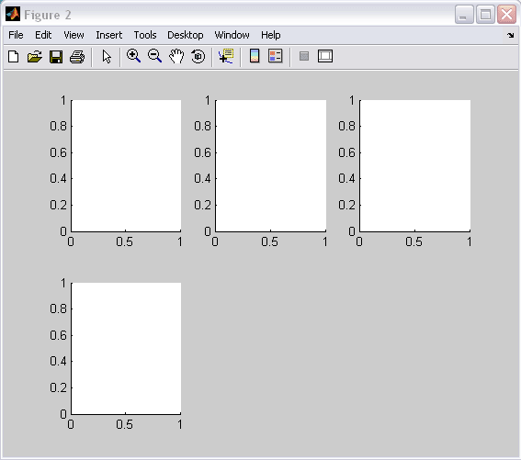
Subplots
subplot(m,n,p) : create a subplot in an array of axes
>> subplot(2,3,1);
>> subplot(2,3,4);
P=1
P=2
P=3
m
P=4
n

Slide 12
Adding Text to Figures
Basic axis labels and title can be added via convenient functions:
>> xlabel('x-axis label text')
>> ylabel('y-axis label text')
>> title('title text')
Legends for line or symbol types are added via the legend function:
>> legend('line 1 caption','line 2 caption',…)
Legend labels are given in the order lines were plotted

Slide 13
‘Handle’ Graphics
MATLAB uses a hierarchical graphics model
Graphics objects organised according to their dependencies: e.g. lines must be plotted on axes, axes must be positioned on figures
Every object has a unique identifier, or handle
Handles are returned by the creating function
ax = subplot(3,2,n)
H = plot(x,y)
Handles can be used to identify an object in order to inspect (get) or modify (set) its properties at any time

Slide 14
Object Hierarchy
The computer desktop
root
Figure window
figure
axes
UI-control
UI-menu
UI-contextmenu
line
light
image
patch
surface
rectangle
text
Objects at any level are considered to be ‘children’ of their ‘parent’ object.

Slide 15
Properties of an object with handle H, can be inspected/modified by:
>> value = get(H,'propertyname')
>> set(H,'propertyname',value)
All property values echoed to screen by:
>> get(H)
3 useful functions:
gcf : get current figure – returns handle of current figure
gca : get current axes – returns handle of current axes
gco : get current object – returns handle of current object Can use these directly, instead of the handle

Slide 16
Current object is last created (usually), or last object clicked on with mouse.
>> pp = get(gca,'position')
pp =
0.1300 0.1100 0.7750 0.8150
>> set(gca,'position',pp+[0 0.1 0 -0.1])
The code above first gets the position of the current axes – location of bottom left corner (x₀, y₀), width (dx) and height (dy) (in normalised units) – then resets the position so that the axes sit 0.1 units higher on the page and decreases their height by 0.1 units.

Slide 17
Other plotting functions
Matlab has many plotting functions – we will use a simple data set representing a surface to try these out.
Enter the command peaks
z = 3*(1-x).^2.*exp(-(x.^2) - (y+1).^2) ...
- 10*(x/5 - x.^3 - y.^5).*exp(-x.^2-y.^2) ...
- 1/3*exp(-(x+1).^2 - y.^2)
Peaks sets up a regular x and y grid, and defines the function z given above.

Slide 18
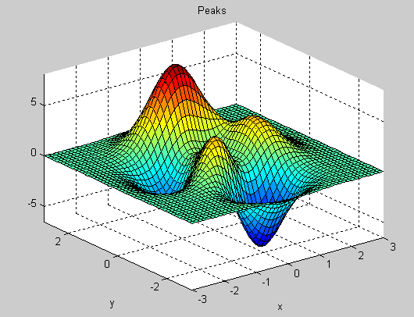
>> peaks;
Peaks is an example function, useful for demonstrating 3D data, contouring, etc. Figure above is its default output.
P=peaks; - return data matrix for replotting…

Slide 19
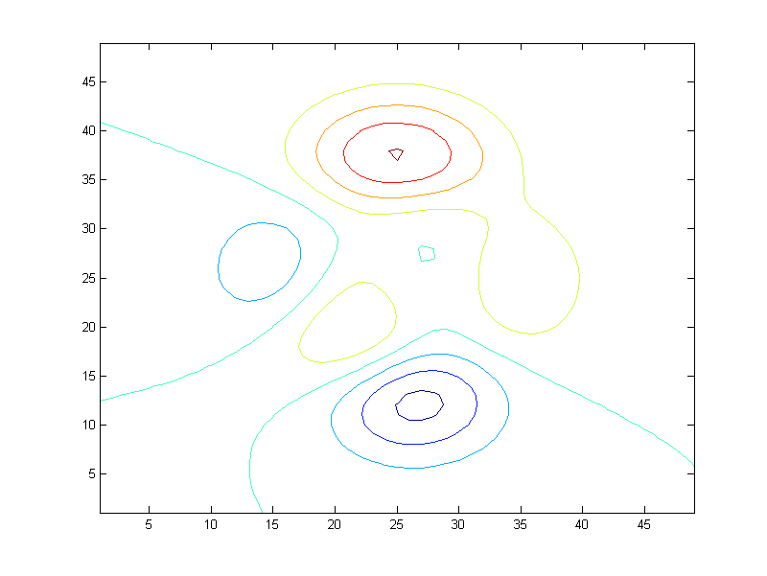
>> P = peaks; - save output of peaks in P
>> contour(P) - contour P using default contour values
x and y axes are simply the row and column numbers

Slide 20
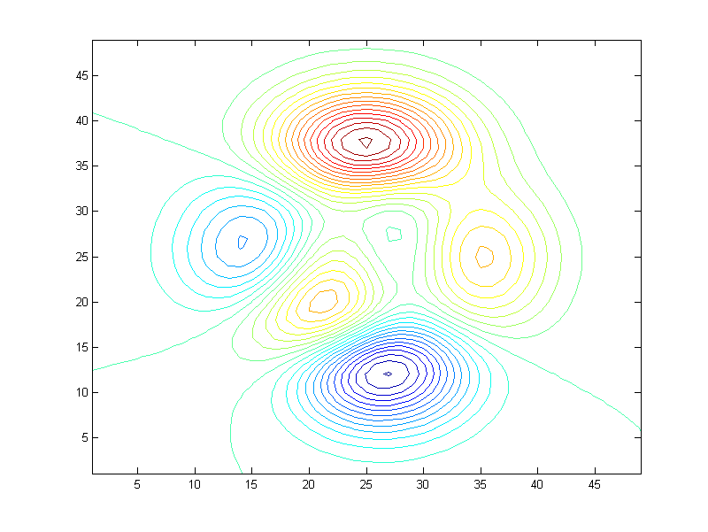
>> contour(P,[-9:0.5:9]) – contour with specified contour values.

Slide 21
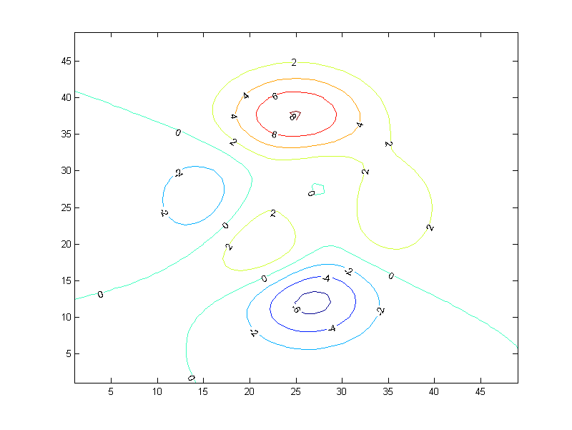
>> [C,h]=contour(P); - capture Contour value and handle
>> clabel(C,h); - clabel function adds labels

Slide 22
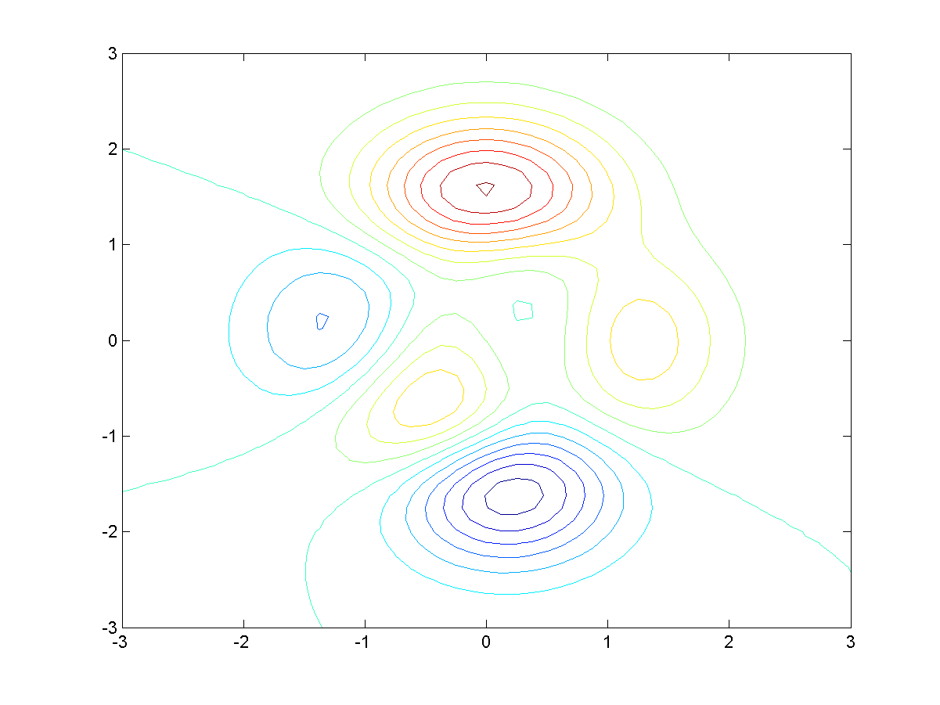
>> [x,y,P] = peaks;
>> contour(x,y,P,[-9:9])
x and y axes are true values

Slide 23
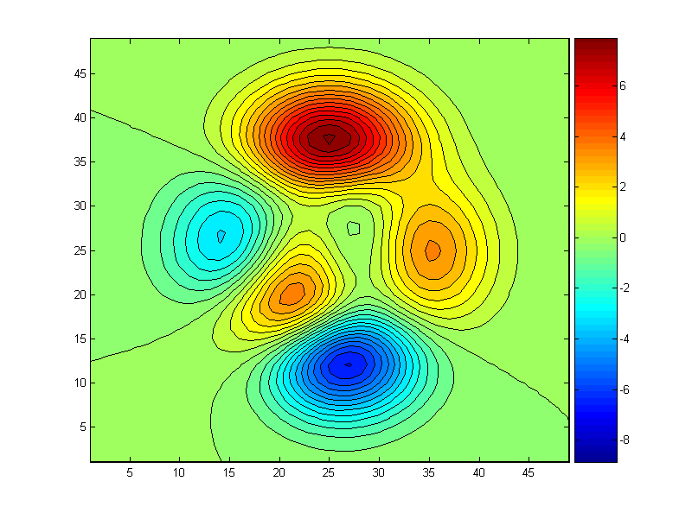
>> contourf(P,[-9:0.5:9]); - filled contour function
>> colorbar - add colour scale

Slide 24
Pseudocolour plots
An alternative to contouring – provides a continuous colour-mapped 2D data field
pcolor(Z) : plot pseudocolour plot of Z
pcolor(X,Y,Z) : plot of Z on grid X,Y
shading faceted | flat | interp : set shading option
faceted : show edge lines (default)
flat : don't show edge lines
interp : colour is linearly interpolated to give smooth variation

Slide 25
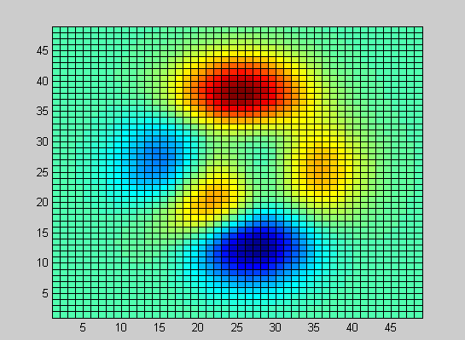
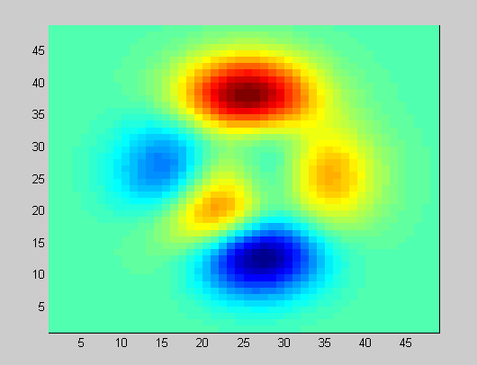
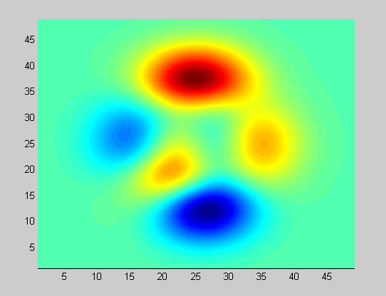
>> pcolor(P)
>> shading flat
>> shading interp
Data points are at vertices of grid, colour of facet indicates mean value of surrounding vertices. Colours are selected by interpolating data range into a colormap

Slide 26
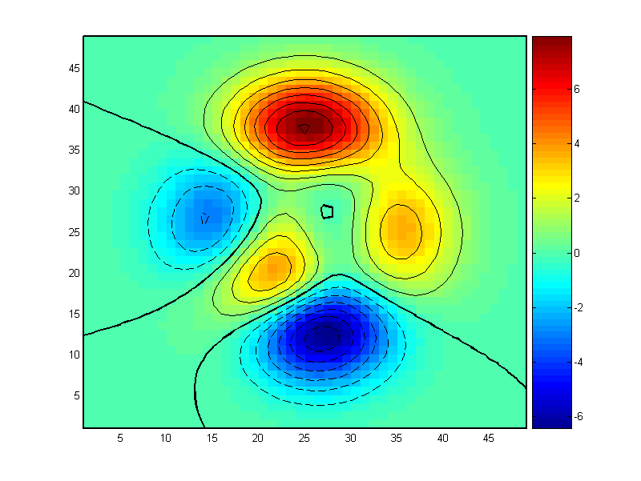
>> pcolor(P);shading flat
>> hold on
>> contour(P,[1:9],'k')
>> contour(P,[-9:-1],'k--')
>> contour(P,[0 0],'k','linewidth',2)
>> colorbar

Slide 27
colormaps
Surfaces are coloured by scaling the data range to the current colormap. A colormap applies to a whole figure.
Several predefined colormaps exist ('jet' (the default), 'warm','cool','copper','bone','hsv'). Select one with
>> colormap mapname
>> colormap('mapname')
The current colormap can be retrieved with
>> map=colormap

Slide 28
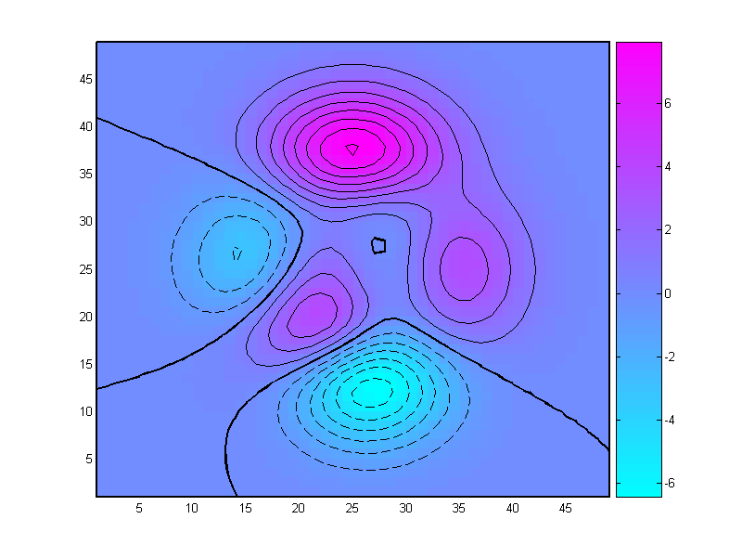
>> colormap cool

Slide 29
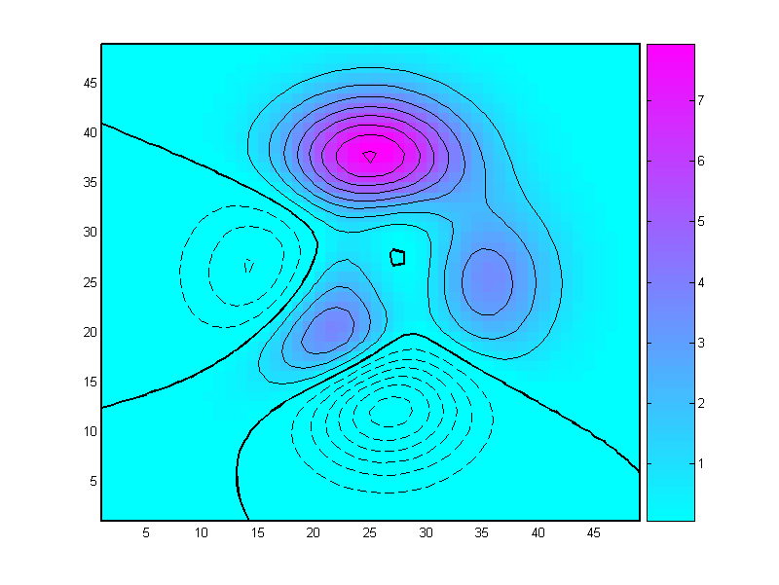
>> caxis([0 8]) - caxis function sets the [min max] limits of
>> colorbar the colour scale. Need to refresh colourbar

Slide 30
Colormaps are simply 3-column matrices of arbitrary length (default = 64 rows). Each row contains the [RED GREEN BLUE] components of the colour required, specified on a 0→1 scale.
e.g.
>> mymap = [ 0 0 0.1
0 0.1 0.2
0.1 0.2 0.3
. . .
. . . ]
>> colormap(mymap)

Slide 31
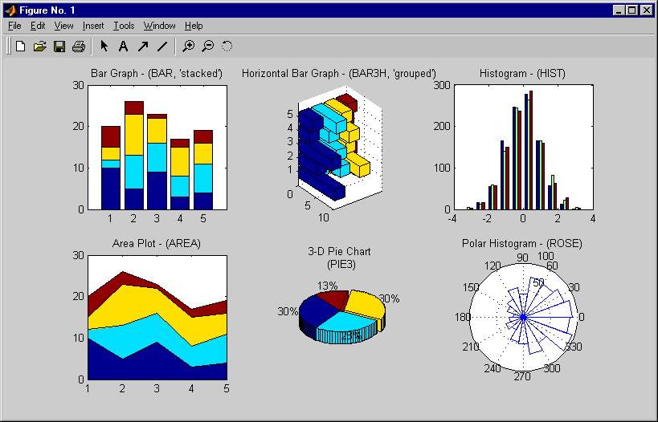
Specialized Plotting Routines
Notes:
Specialized Plotting Routines
>> help bar
>> help bar3h
>> help hist
>> help area
>> help pie3
>> help rose

Slide 32
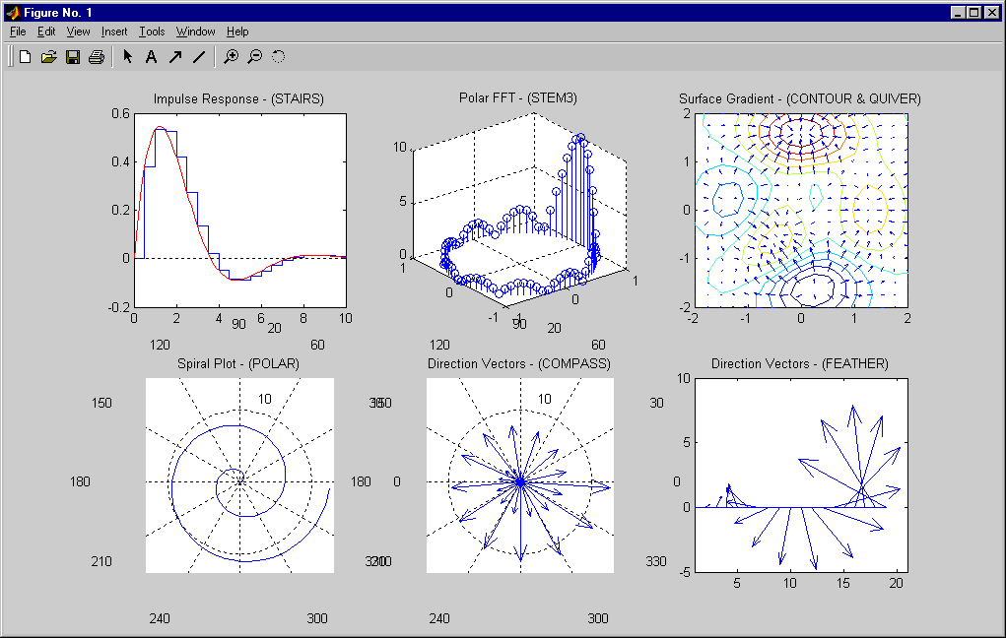
Specialized Plotting Routines (Continued)
Notes:
Specialized Plotting Routines
(Continued)
>> help stairs
>> help stem3
>> help contour
>> help quiver
>> help polar
>> help compass
>> help feather

Slide 33
Load jun07_all_5km_means.mat
Variables:
mlat, mlon - latitude & longitude of measurements
mT - mean air temperature
msst - mean sea surface temperature
mu, mv - mean wind components to east (x) and north (y)
mws - mean wind speed
Plot the different variables to get a feel for range of values and relationships between them.
Plot positions of the points - geographical locations

Slide 34
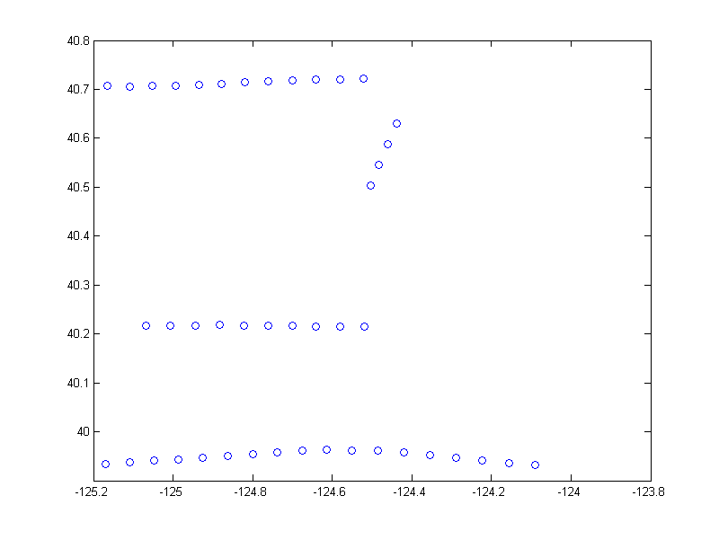
>> load jun07_all_5km_means.mat
>> who
Your variables are:
mT mlat mlon msst mu mv
>> plot(mlon,mlat,'o‘)

Slide 35
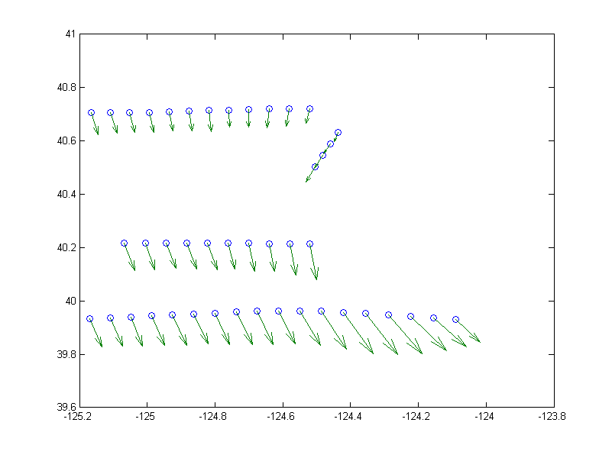
>> plot(mlon,mlat,'o')
>> hold on
>> quiver(mlon,mlat,mu,mv)

Slide 36
Randomly distributed data can’t be used with contour, pcolor, surf, etc…data needs to be on a regular grid.
Use meshgrid to generate arrays of x and y on a regular grid.
[XX,YY] = meshgrid([-125.2:0.05:-124],[39.9:0.05:40.8]);
Use griddata to interpolate mu and mv onto the XX,YY grid … use system help to check usage
X-values required
Y-values required
X and Y grids

Slide 37
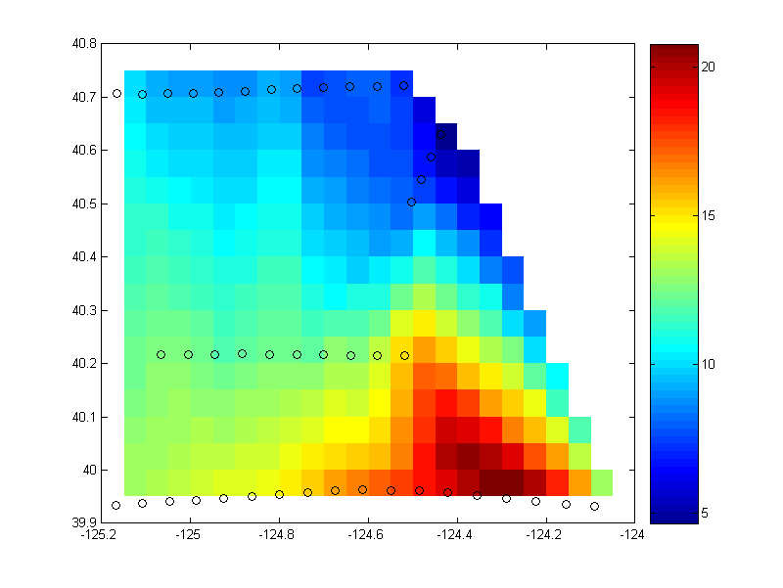
>> [XX,YY] = meshgrid([-125.2:0.05:-124],[39.9:0.05:40.8]);
>> gmws = griddata(mlon,mlat,mws,XX,YY);
>> pcolor(XX,YY,gmws); shading flat;
>> hbar = colorbar;
>> hold on
>> h1 = plot(mlon,mlat,'ko');

Slide 38
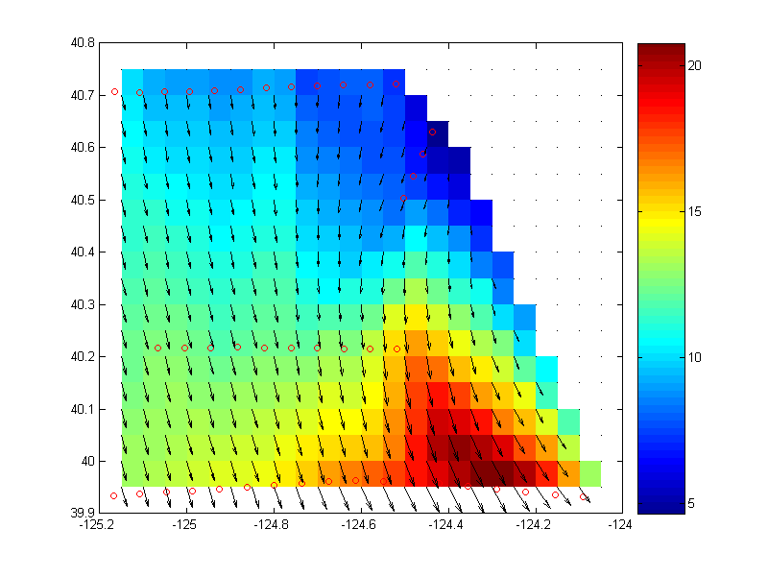
>> gu=griddata(mlon,mlat,mu,XX,YY);
>> gv=griddata(mlon,mlat,mv,XX,YY);
>> quiver(XX,YY,gu,gv,'k-');
>> set(h1,'markeredgecolor','r','markersize',5)

Slide 39
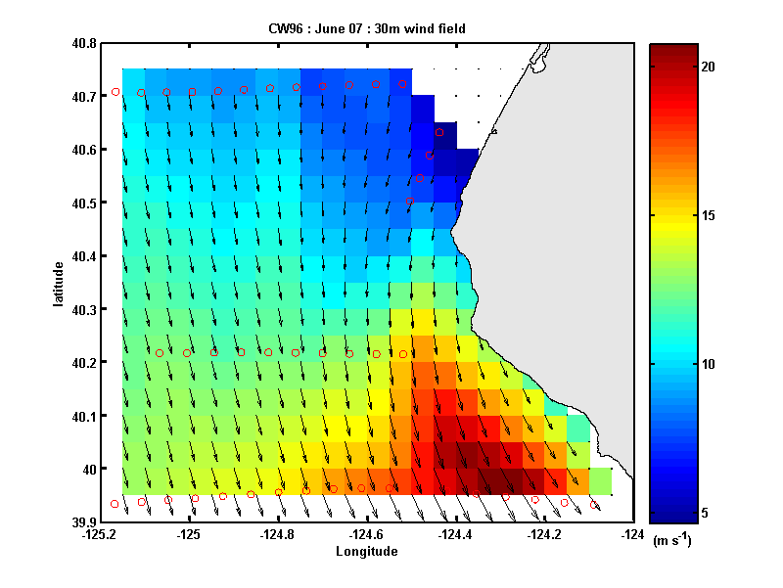
>> set(gca,'linewidth',2,'fontweight','bold')
>> xlabel('Longitude'); ylabel('latitude')
>> set(hbar,'linewidth',2,'fontweight','bold')
>> set(get(hbar,'xlabel'),'string','(m s^{-1})','fontweight','bold')
>> xlabel('Longitude'); ylabel('latitude')
>> title('CW96 : June 07 : 30m wind field')
>> load mendocinopatch.mat
>> patch(mendocinopatch(:,1),mendocinopatch(:,2),[0.9 0.9 0.9])

Slide 40
Printing
From file menu:
‘print’ to send to a printer
Export to export to a file (gif, png, jpg, eps,…)
Better to use command line
> print filename.EXT -dEXT
Instruction to print engine to select file type (same format as a linux print destination)
File-type extension ‘png’, ‘ps’, ‘.eps’ appropriate to file type you want

Slide 41
> print myfigure.png -dpng
> print myfigure.png –dpng –r300
-rNNN option specifies print resolution to NNN dpi

Slide 42
Common print file types
.ps - postscript (full page)
.eps - encapsulated postscript (embeddable, infinitely scalable vector graphic – best for publication)
.png - portable network graphic – best bitmap image option
.jpg - JPEG image NEVER USE THIS!

Slide 43
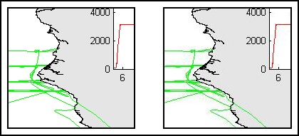
.png
.jpg
JPEG format is designed for photographic images with continuously varying tone. Hard edges suffer compression artefacts – distortions – ugly, and can make text impossible to read

Slide 44
.fig files
> hgsave(gcf,’filename.fig’)
Saves the current figure to a .fig file – this is a complete description of the figure as a set of matlab handle-graphics objects. Can reload the figure to make edits later
> hgload(‘filename.fig’)

